Slide 1
Virtual BDPA Sites
HTML Foundations

Slide 2
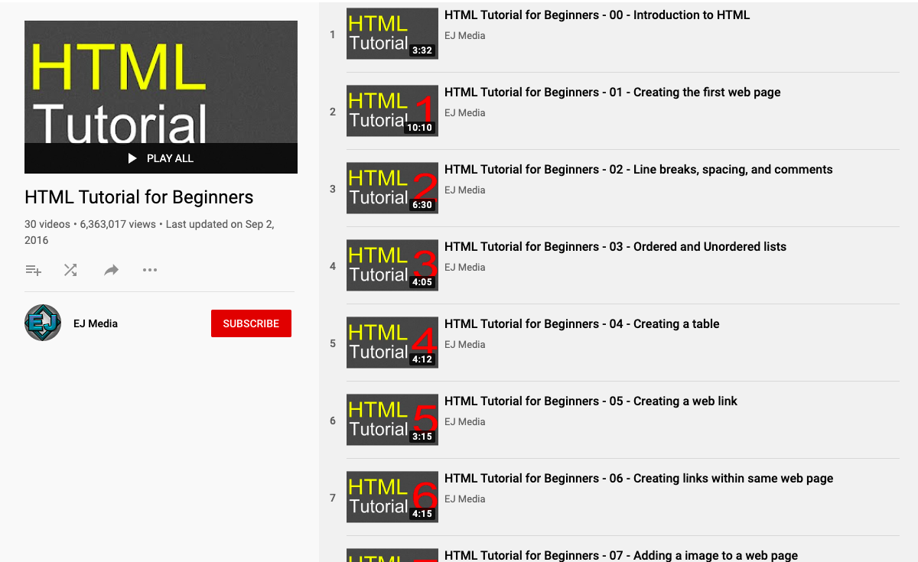
Video Lesson
https://www.youtube.com/playlist?list=PLr6-GrHUlVf_ZNmuQSXdS197Oyr1L9sPB
Watch the video series using the link at the top.
You will watch HTML Tutorial for beginners #s 03-05. (last video title should be “HTML Tutorial for beginners-05”)
You must provide 3 NOTES for each video!!!

Slide 3
Assignment
In the “Basic HTML and HTML5” Module of FREECODECAMP.org complete the below sections:
External Pages with Anchor Elements
Internal Sections of a Page with Anchor Elements
Nest an Anchor Element within a Paragraph
Make Dead Links Using the Hash Symbol
Turn an Image into a Link
Create a Bulleted Unordered List
Create an Ordered List
Create a Text Field

Slide 4
Next Steps
Once you have completed the free code camp modules you must email Sierra and Eric stating you have completed the modules along with your notes from the video
Emails: Sierra.Doucette@bdpa.org & Eric.Ejiofor@bdpa.org
Saturday @ 9am join the class online call
You should have received the invite in your email
(Parents have received the invite link as well if you did not!)

